Slide 1
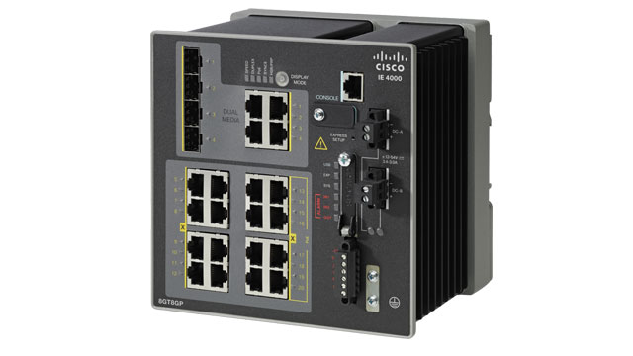
PLC
PLC
PLC
AHOD
Web Server
Cisco Spark
PLC
PLC
PLC

